Slide 1
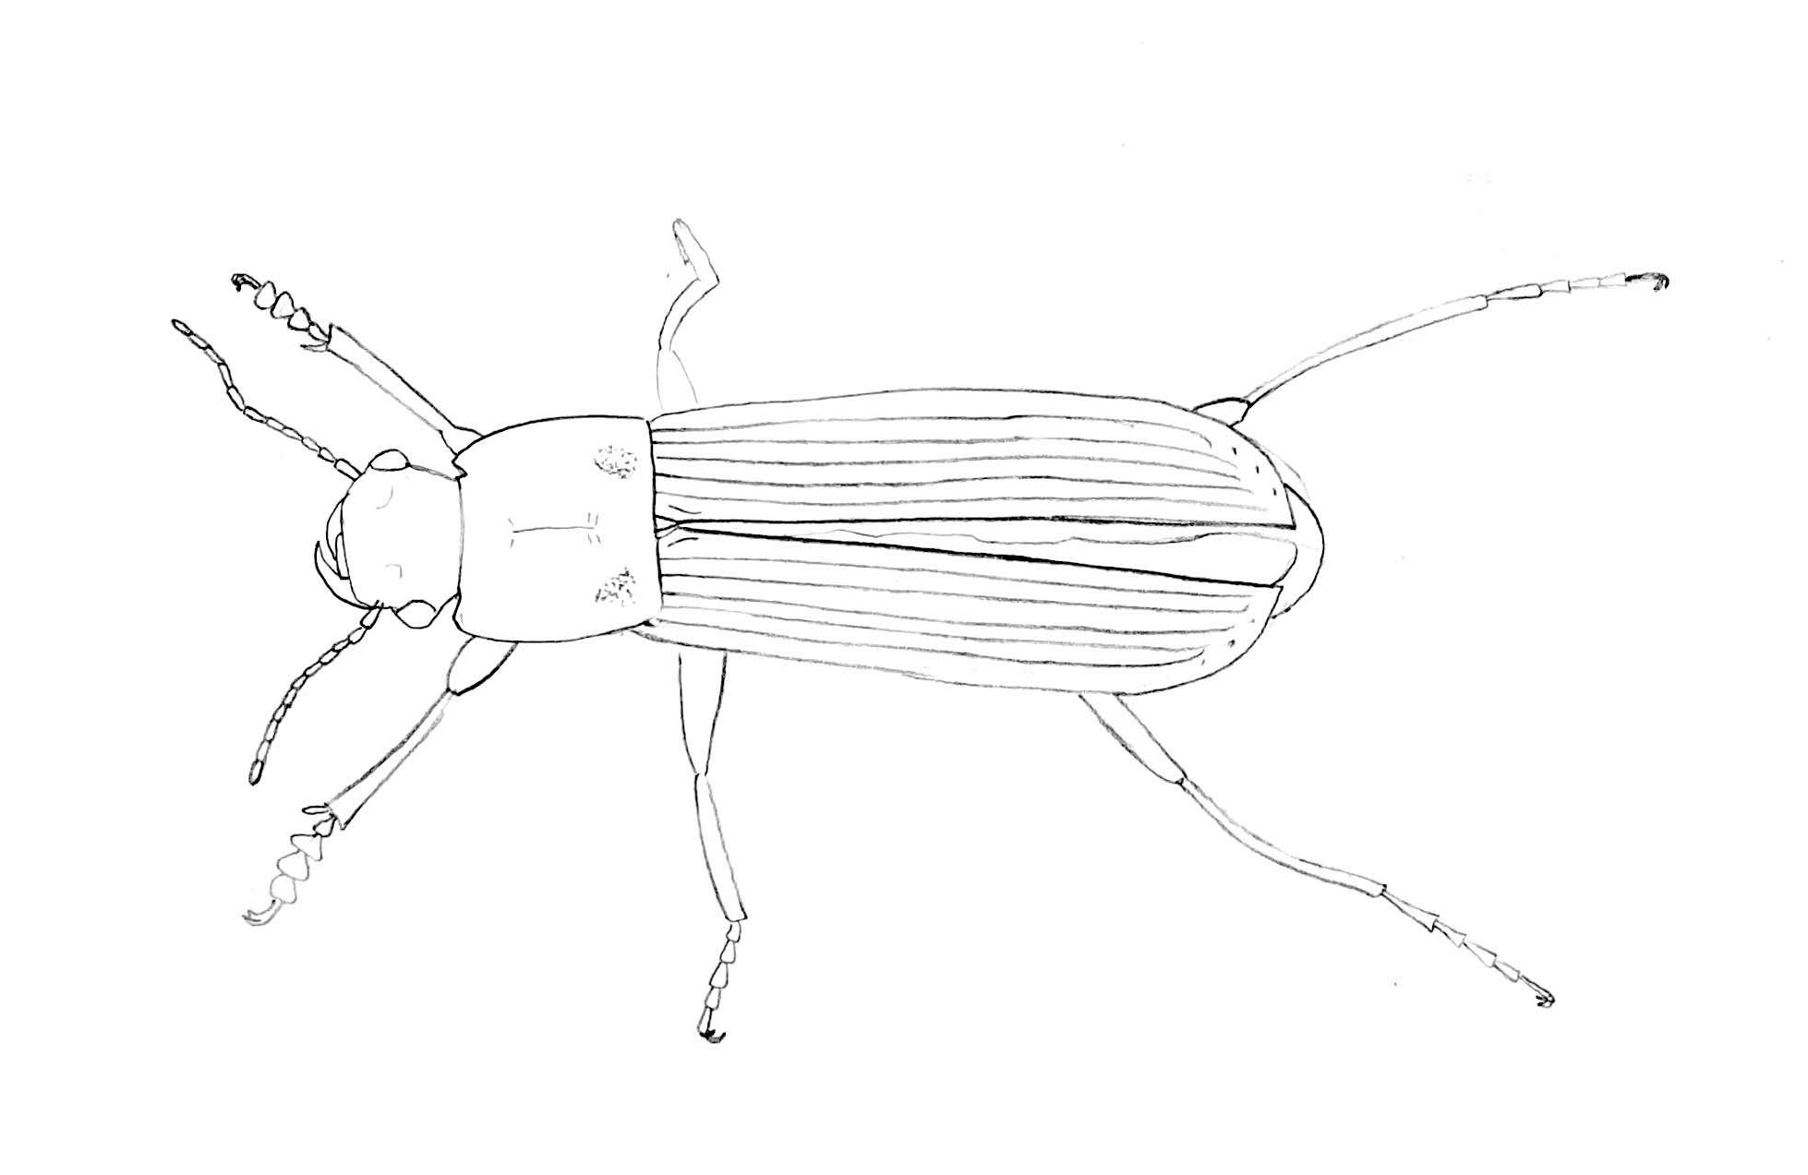
e
h
w
a
f
t

Slide 2
a
h
j
e
f
i
l
k
g
b
c
d

Slide 3
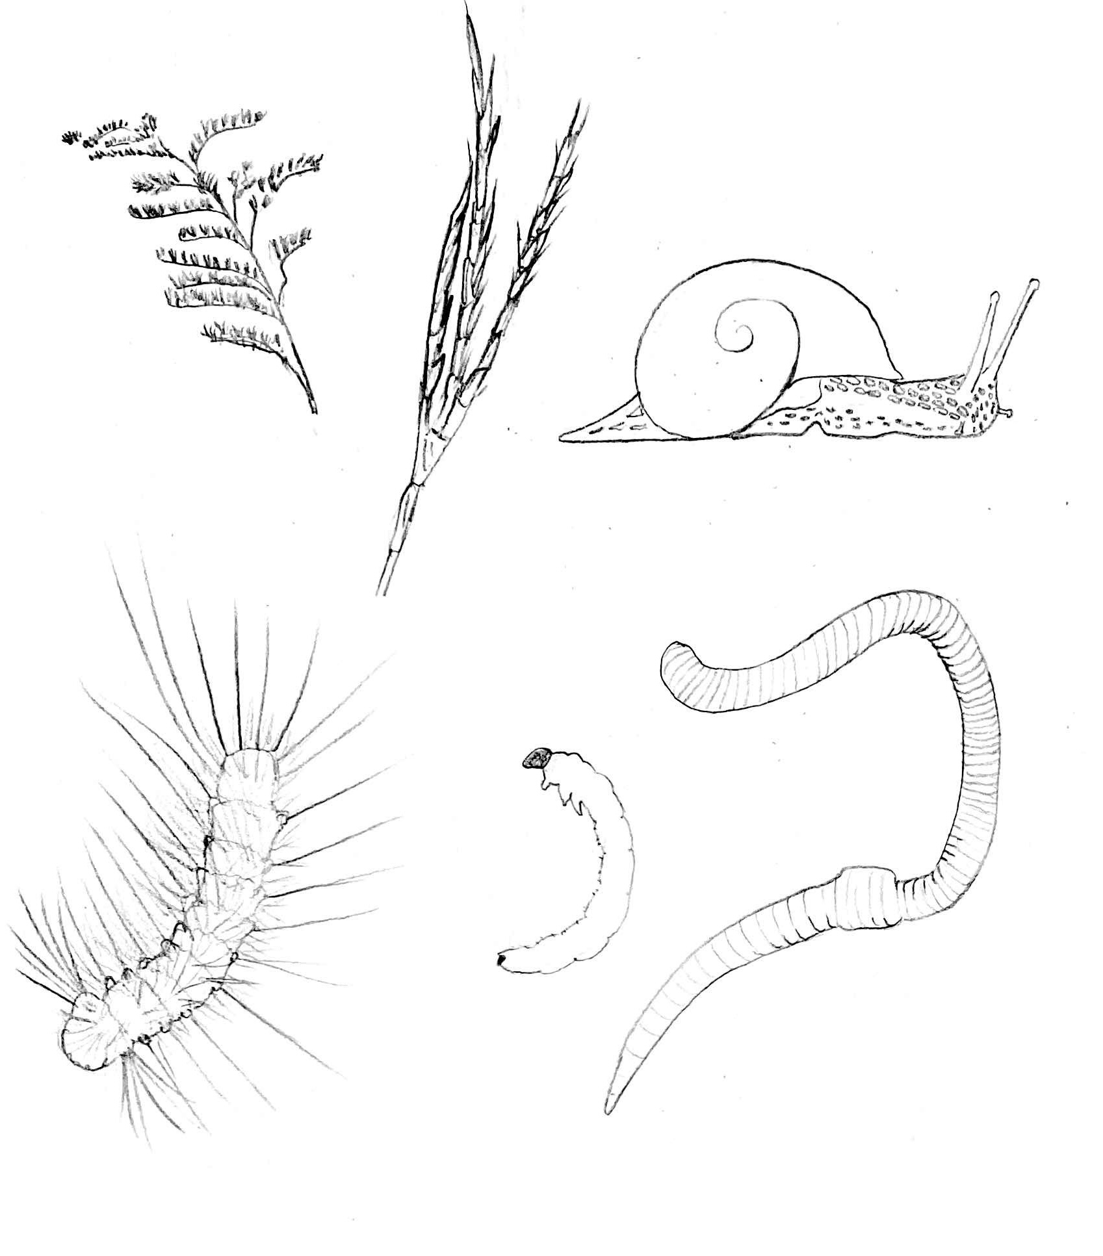
plant seeds
gastropods
annelids
beetle larvae
caterpillars

